Slide 1
Japan’s AI Strategy toward Society 5.0
Takao Nitta / Cabinet Office of Japan

Slide 2
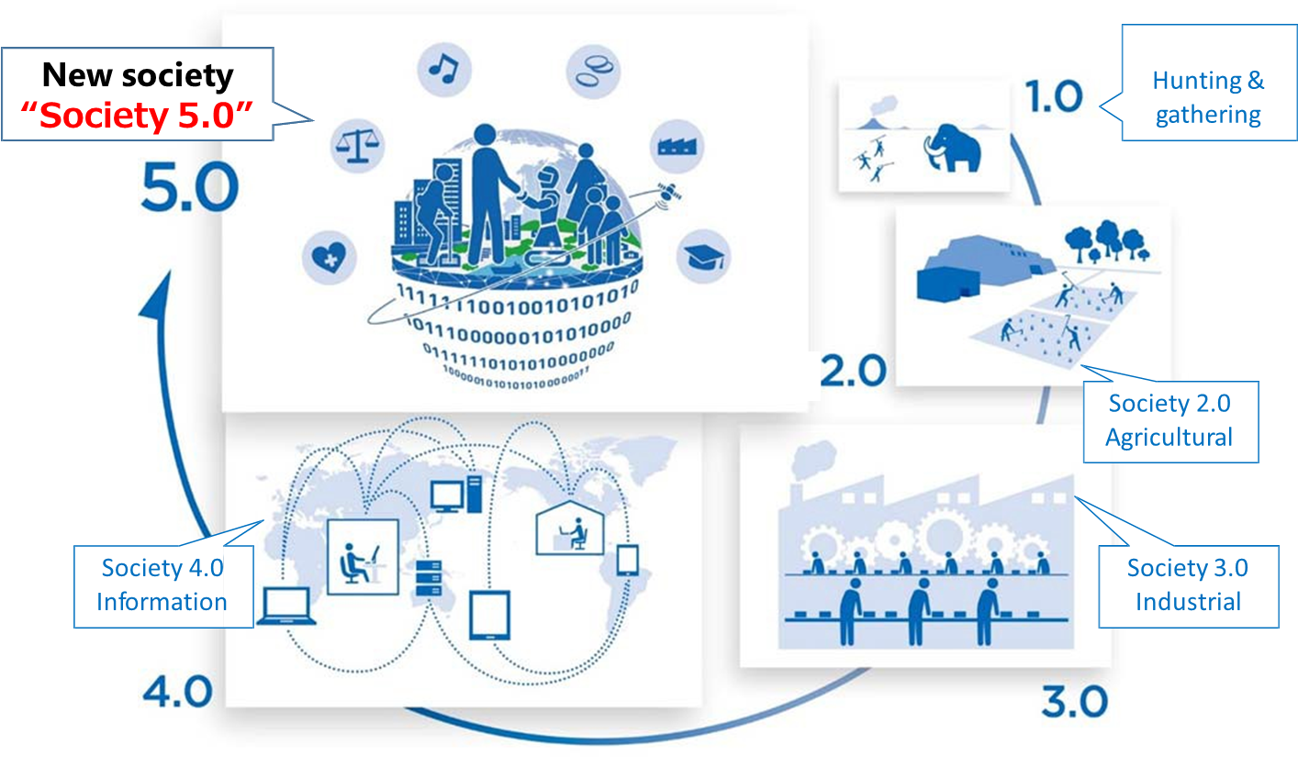
What is Society 5.0?
Realize the advanced fusion of cyberspace and physical space
To balance economic advancement with the resolution of social problems
Bring about a human-centric society

Slide 3
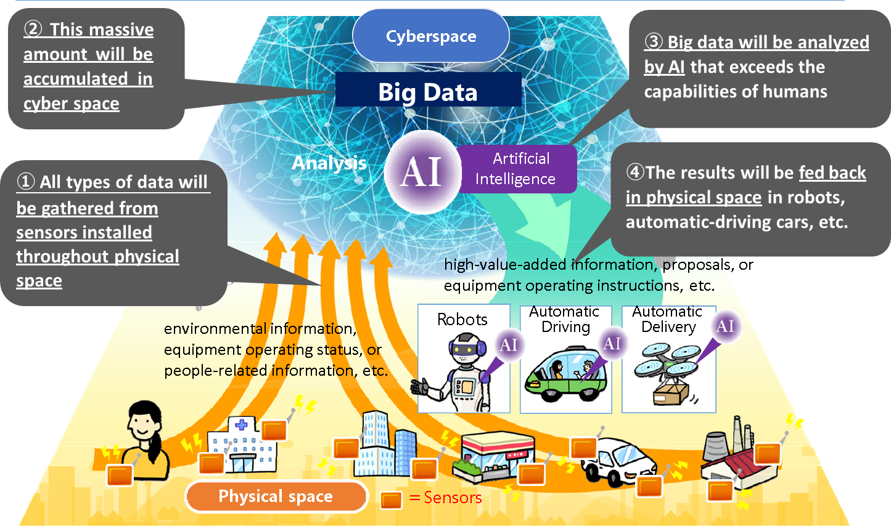
Advanced Fusion of CPS (Cyber and Physical Space)
All types of data will be gathered from sensors installed throughout physical space via IoT.
This Big Data will be analyzed by AI, and the results will then be fed back in physical space.

Slide 4
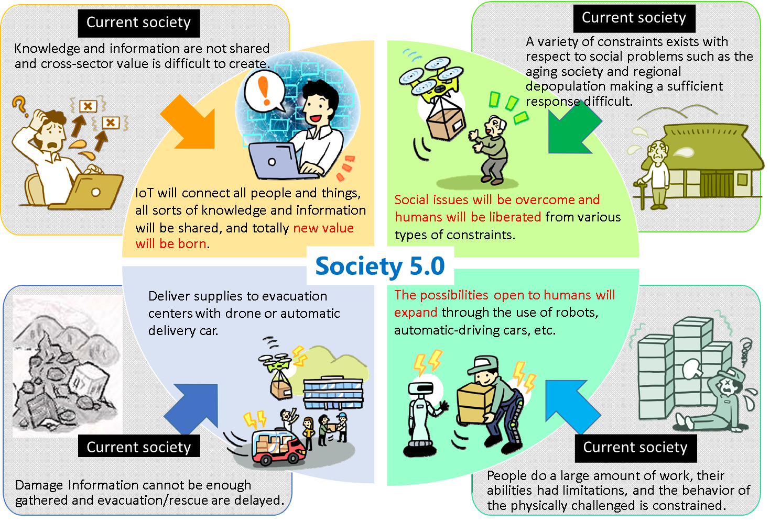
Solution of Social Problems and Economic Growth

Slide 5
Human Centric Society
Dignity
Use AI to augment capability and creativity, and engage in rewarding job
Create new values by diverse people
(elderly / young, male / female, urban / rural, etc.)
Human-centric Society
Diversity
&
Inclusion
Sustainability
Approach national and global issues with AI
(climate change, disparities and resource depletion, etc.)

Slide 6
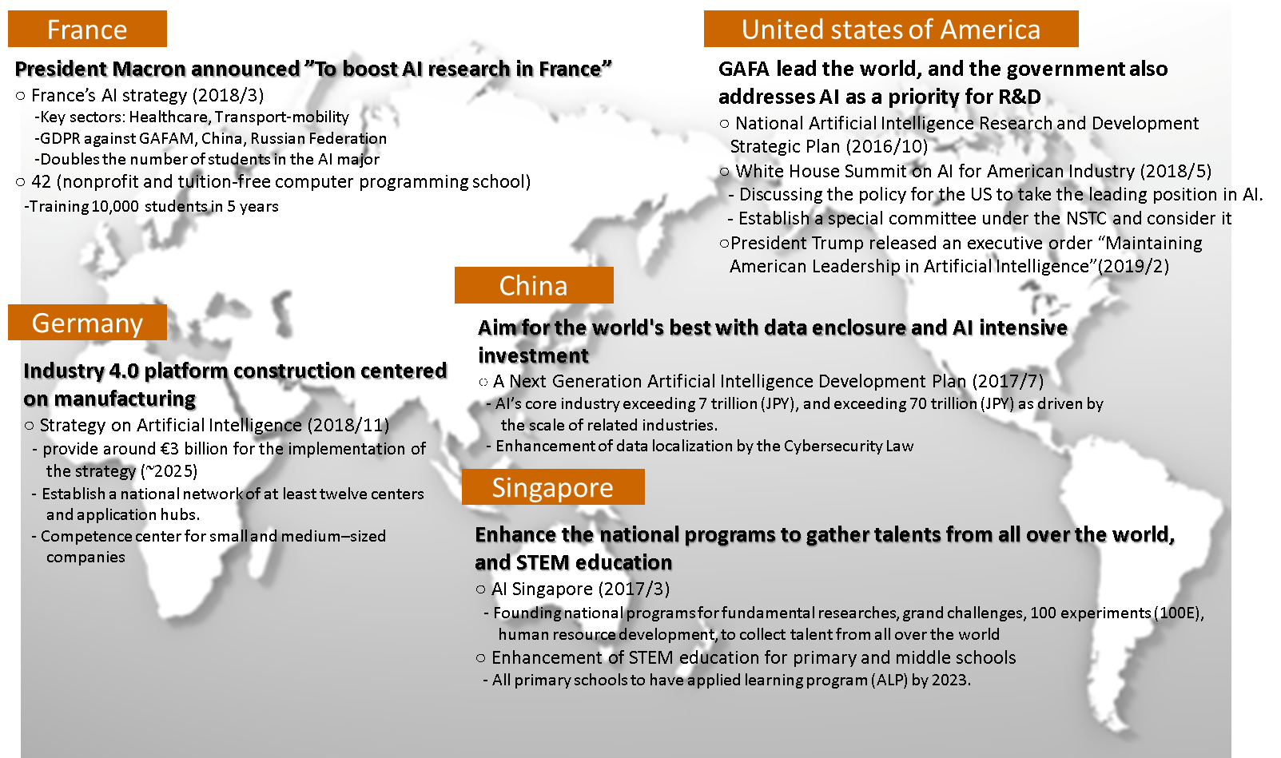
An Overview of National AI Strategies

Slide 7
Japan’s AI Strategy toward Society 5.0
Educational Reform - Foundation for human resource development
Research & Development - Attractive Research & Development environment
Deployment to Real-World - Fusion of AI and data
Data - Establishment of mechanism for ensuring trust of AI
ELSI - Social Principles of Human-centric AI

Slide 8
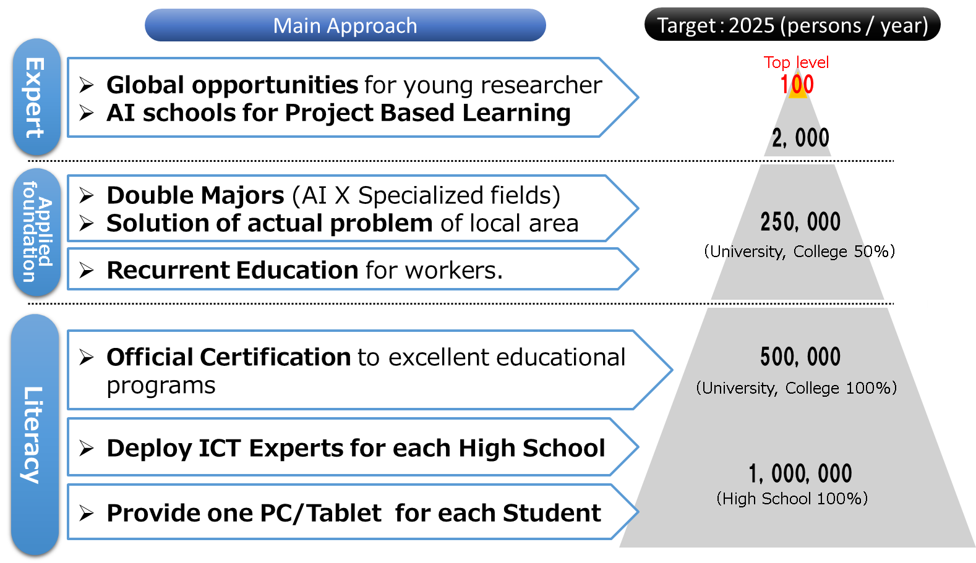
1 Education Reform
Reform of educational system that everyone can acquire AI literacy for correct understanding and use of AI like "reading, writing and arithmetic" .

Slide 9
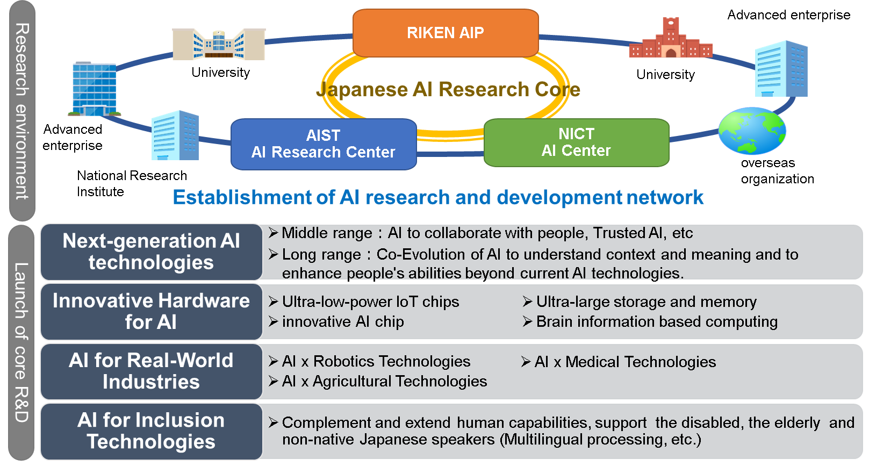
2 Research & Development
Making Japan an attractive base for researchers from around the world.
Strategic promotion of next-generation AI technologies and enabling environment for innovative emerging research.

Slide 10
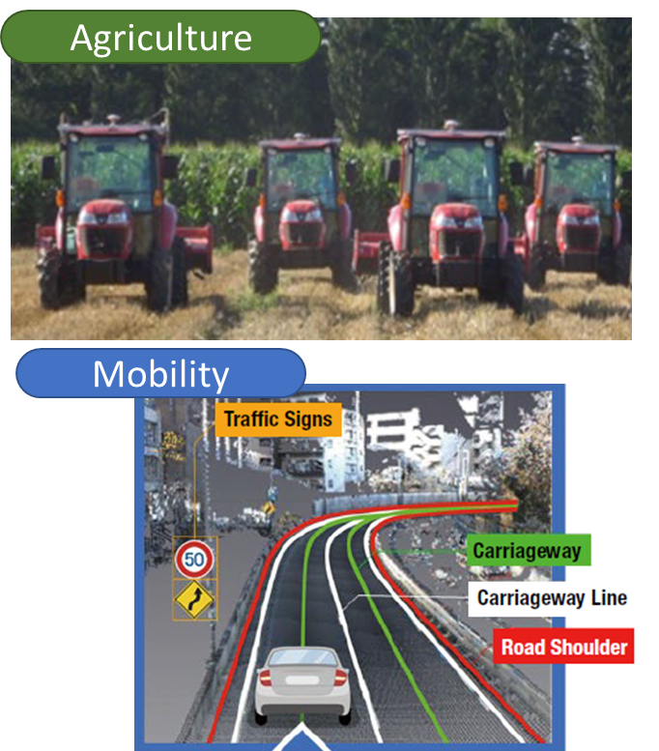
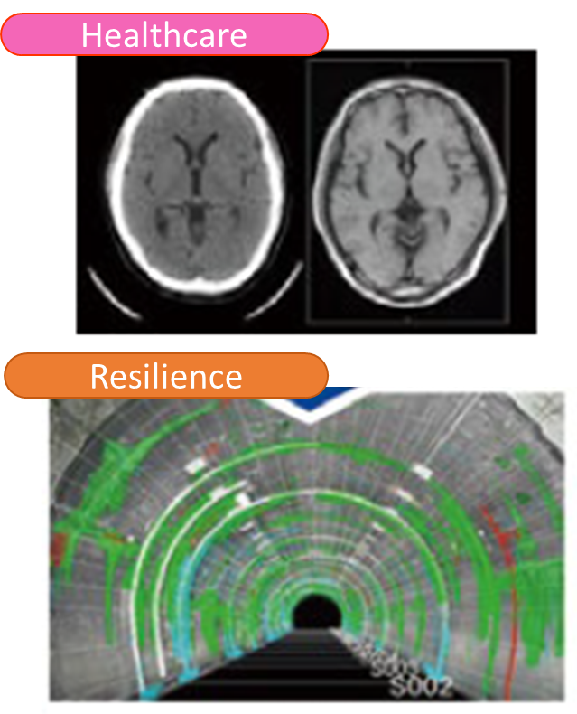
3 Deployment to Real-World
Fusion of AI and data in Japan's strong areas to address social issues and consequently realize diverse and sustainable society.

Slide 11
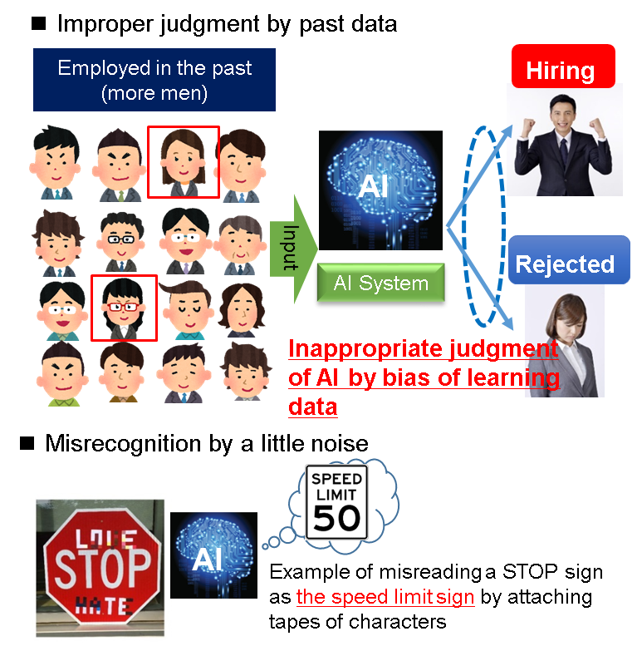
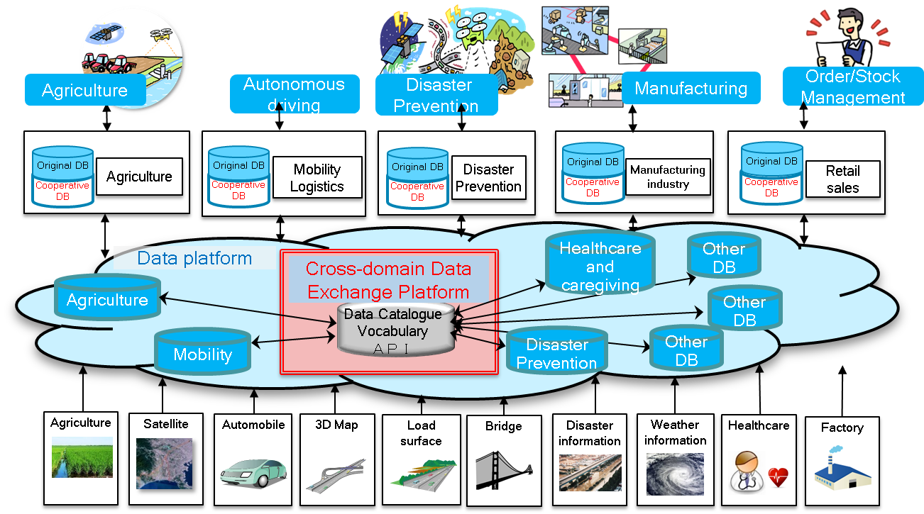
4 Data- Mechanism for Ensuring Trusted Data and AI
Establishment of “Cross Domain Data Exchange Platform” that enables all data to be used safely and at an AI level.
In order to implement safe and reliable social packaging of AI, reliable quality data is required to ensure reliability of AI products and services.

Slide 12
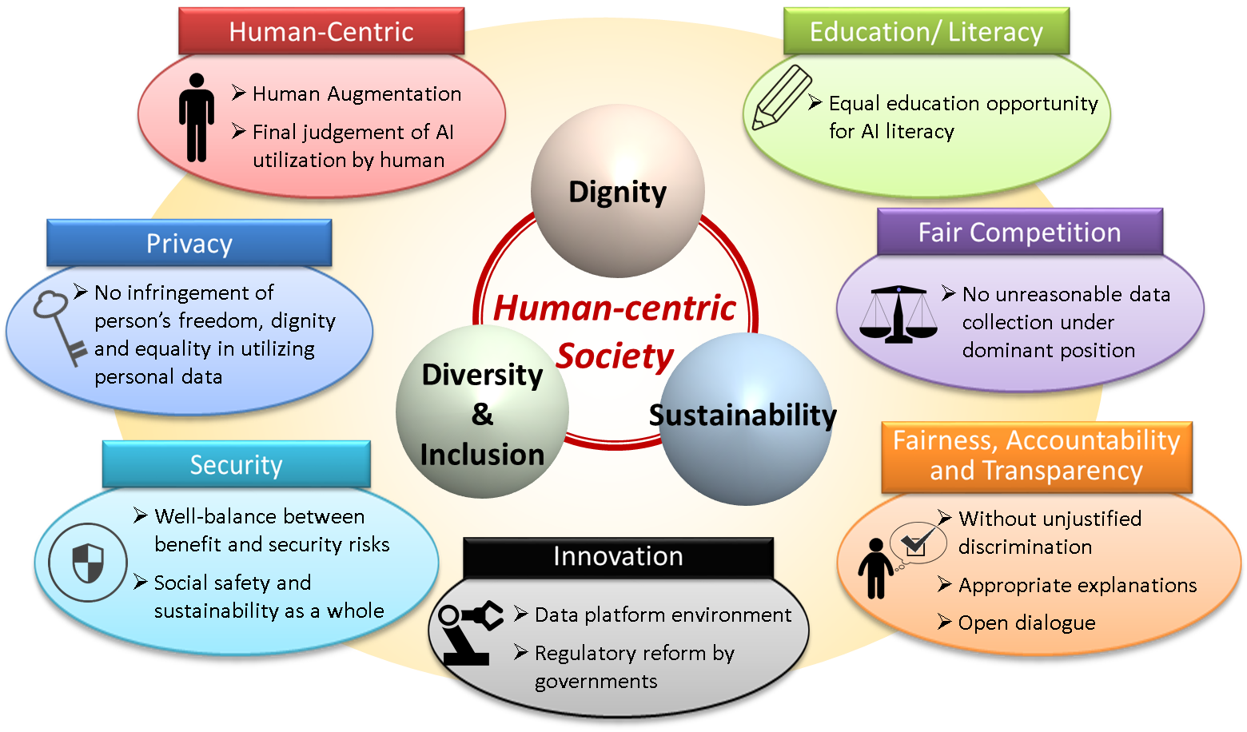
5 AI Ethics, Social Principles
Three basic philosophies and seven principles

Slide 13
G20 Osaka Leaders’ Declaration (28-29 June, 2019)
FOSTERING ROBUST GLOBAL ECONOMIC
Innovation: Digitalization, Data Free Flow with Trust
12. …The responsible development and use of Artificial Intelligence (AI) can be a driving force to help advance the SDGs and to realize a sustainable and inclusive society. To foster public trust and confidence in AI technologies and fully realize their potential, we commit to a human-centered approach to AI, and welcome the non-binding G20 AI Principles, drawn from the Organization for Economic Cooperation and Development (OECD) Recommendation on AI. …
G20 AI Principles
Section 1: Principles for responsible stewardship of trustworthy AI
1.1. Inclusive growth, sustainable development and well-being
1.2. Human-centered values and fairness
1.3. Transparency and explainability
1.4. Robustness, security and safety
1.5. Accountability
Section 2: National policies and international co-operation for trustworthy AI

Slide 14
Summary
1 Human-centric AI
The third wave of AI has come into our society and has been changing our daily life drastically.
The rapid expansion of AI utilization raises public concerns (“Light and shadow”).
Human-centric approach is necessary to promote public trust for AI.
2 AI strategy for human-centric AI
Japan’s government discussed and formulate social principles prior to AI strategy.
AI strategy to promote AI implementation for the future society to be realized, with the concept of “Human-centric”.
3 International promotion
Japan intends to lead the world in development of decent AI society by sharing social principles for human-centric AI with other countries.

