Slide 1
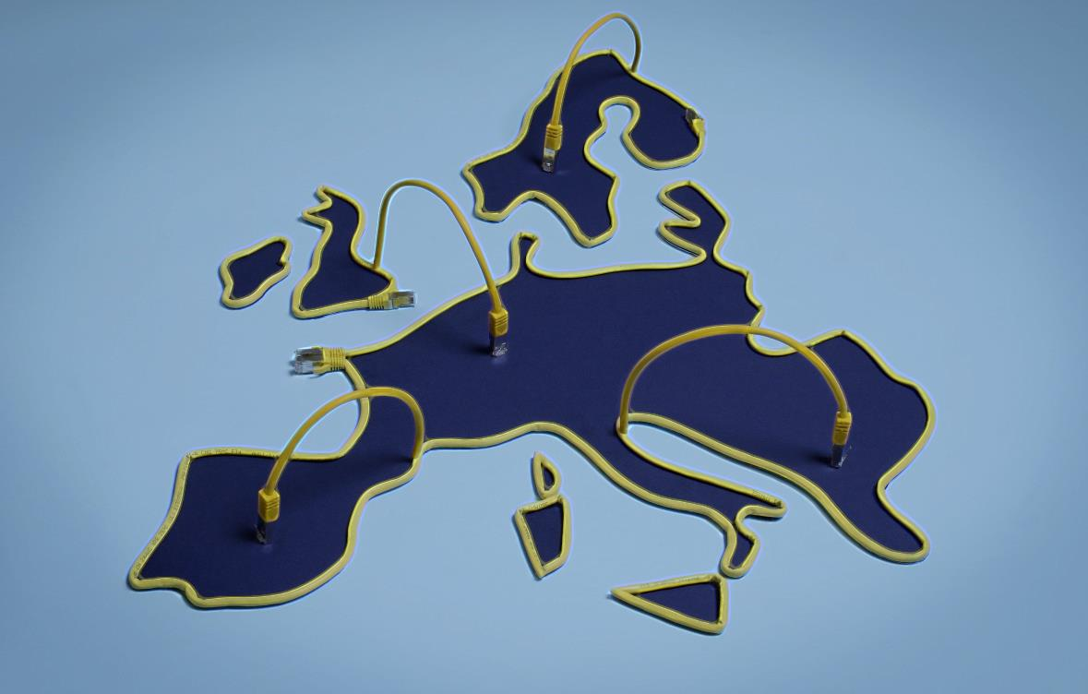
Online Platforms
Opportunities and Challenges for the DSM

Slide 2
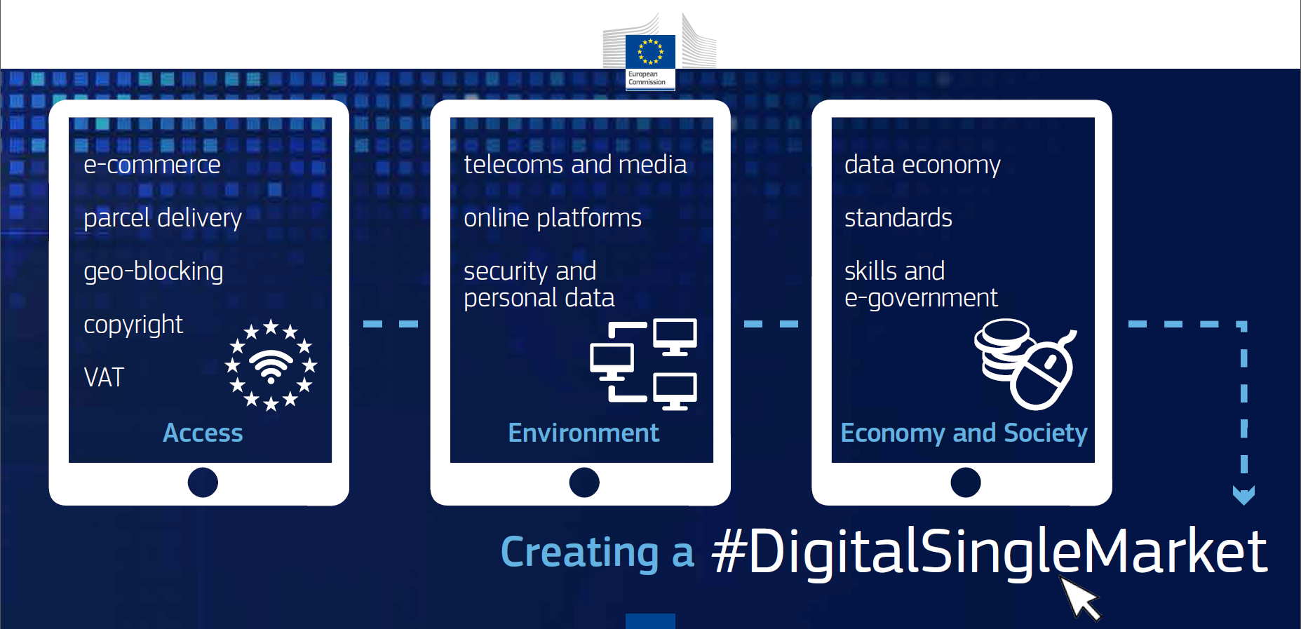
Creating a Digital Single Market

Slide 3
Comprehensive Assessment of the Role of Online Platforms
Public Consultation
Studies
JRC
Euro-barometer
May 2015
Sep '15 -Jan '16
Oct '15 - Feb '16
Oct '15 -May '16
25 May 2016
DSM Strategy
Workshops
COM on
Platforms

Slide 4
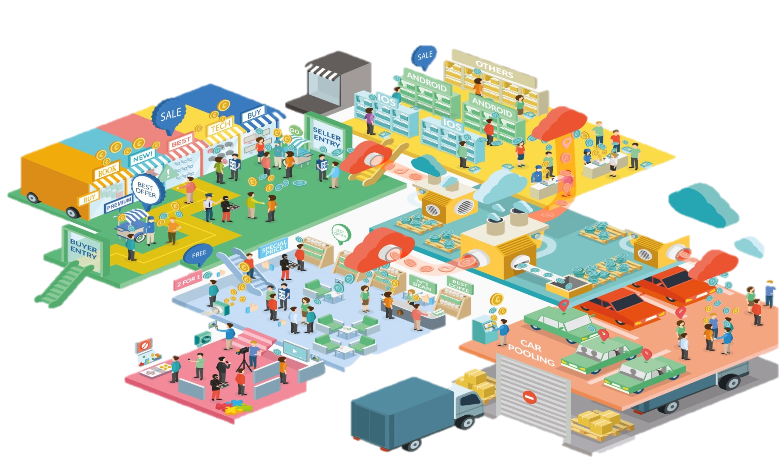
1. Capacity to facilitate, and extract value, from direct INTERACTIONS or transactions between users
2. Collect, use and process a large amount of personal and non-personal DATA to provide optimized experience
4.Create and shape NEW MARKETS and ability to organize new forms of civil participation
3.Capacity to build NETWORKS & interdependency between platform's customer groups

Slide 5
Magnet
for Innovation
EUR 140 billion
in time saved from using search engines in Europe
Forefront of developments
virtual reality, self-driving cars
IoT, Big Data, AI
Benefits of Online Platforms
Benefits
to Consumers
Benefits to Business
EUR 195 billion
global economic impact of Facebook as a catalyst for economic activity
Up to 75%
reduced recruitment
costs for employers
Benefits
to
Society

Slide 6
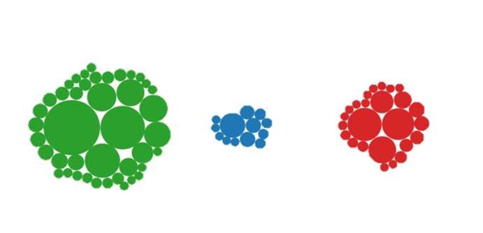
Why is an EU policy approach to platforms necessary?
EU currently represents only 4% of the total market capitalisation of the largest online platforms and lags behind in terms of start-up platforms
N. America
Europe
Asia
42 / $191b
13 / $28.6b
25 / $79.5b

Slide 7
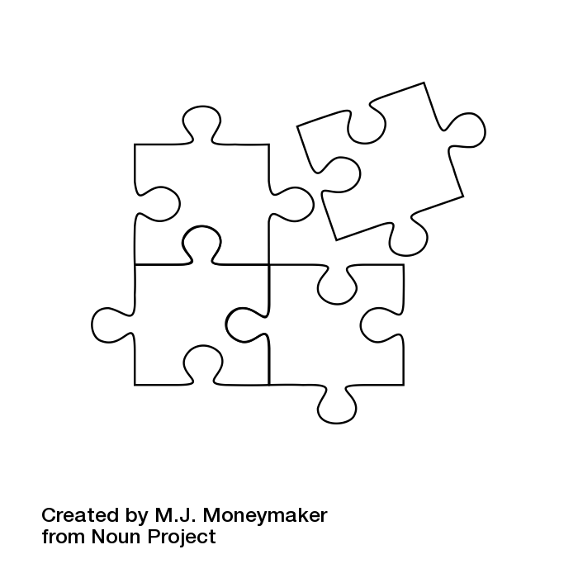
The Commission's Approach
Embrace the platform revolution…
… by effectively tackling emerging issues
Co-regulation &
Capital
Markets
Union
Proportionate
compliance
voluntary efforts
Horizon
2020
Problem-driven
EFSI
approach
Evaluate
existing
frameworks
DSM
Strategy

Slide 8
Level Playing Field
Comparable digital services should be subject to similar or the same rules.
Acting Responsibly
Maintaining the limited liability regime as an engine for innovation while fostering greater responsibilities for platforms on specific issues.
Trust, Transparency & Fairness
Transparency and fairness for maintaining user trust and safeguarding innovation.
Open Markets
Keeping markets open and non-discriminatory to
foster a data-driven economy.

Slide 9
